Slide 1

Upišite se

Slide 2
Android app architecture
Android Dev Academy 2024
David Takač

Slide 3
Content
Why we need architecture
Presentation and business Logic
Model-View-ViewModel
Live demo
Homework
Further reading
Questions

Slide 4
Why we need architecture

Slide 5
Counter Example
Put everything in onCreate
Try adding functionality
Hard to understand later
Especially for colleagues
Minimize time spent understanding someone’s mess

Slide 6
The Need For Structure
Organize code so that it is easy to:
Understand
Upgrade and fix
Test

Slide 7
Software Architecture
Organized way to split code into decoupled and cohesive units
Useful ways become de facto standards
Recognized by developers within the domain
Code is split by “concerns”

Slide 8
Presentation and Business Logic

Slide 9
Presentation Logic
Displays app data
Allows interaction with app data
Should not handle data processing or storage

Slide 10
Business Logic
Provides app data
Modifies app data
Should not care about how data is displayed

Slide 11
Why Mixing These Is Bad
Android owns the presentation layer
You own the business logic/state layer
Depending on presentation to store state results in data loss
UI changes can accidentally break logic, and vice versa
Way harder (if not impossible) to test

Slide 12
Solution: Clear Separation
Instead, clearly separate these two layers
With architectural patterns like MVVM

Slide 13
Model-View-ViewModel (MVVM)

Slide 14
Model-View-ViewModel
Architectural pattern that enforces this separation
Divides app into
Model: Business logic
ViewModel: Presentation logic
View: Presentation logic
Fits perfectly with Compose and state-driven UI

Slide 15
Model
Data layer
Encapsulates business logic and app data
Retrieves data from data source
Modifies data in data source
Hides its data sources

Slide 16
View
UI layer
Displays data from ViewModel
Forwards user actions to ViewModel
Pure Android/Compose

Slide 17
ViewModel
Bridge between Model and View
State holder
Outlives View
Transforms Model data into View data (UI state)
Exposes UI state reactively
Decides how to transform Model data based on user input

Slide 18
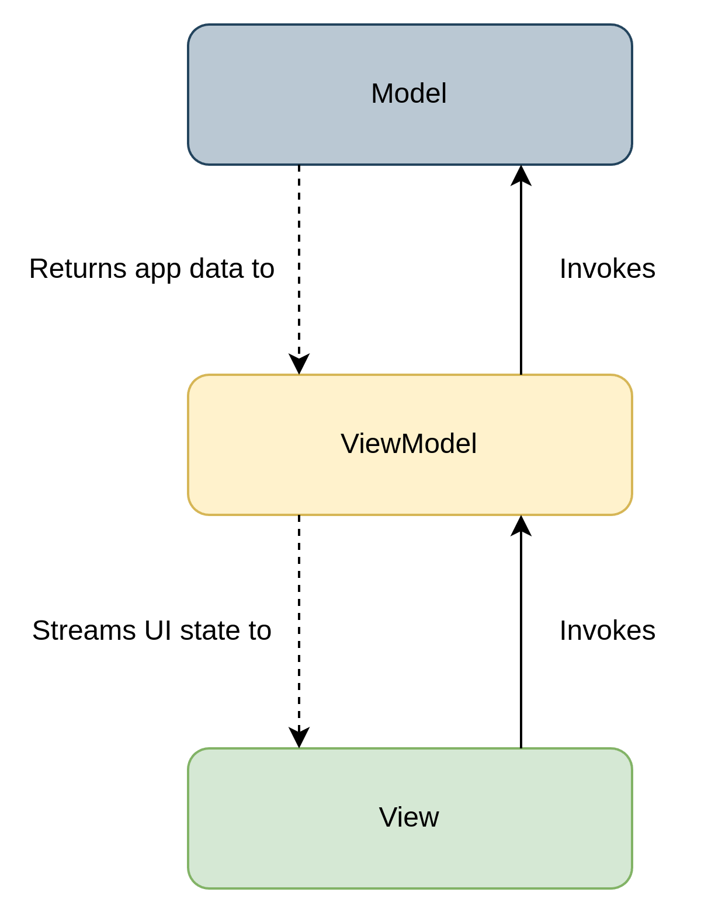

Slide 19
Live Demo

Slide 20
Quotes App
Home screen that presents greeting and some quotes
Settings screen that presents username and some app settings
Opens edit screen when username clicked
Change has to be reflected immediately on home and settings
Implement using MVVM

Slide 21
Homework

Slide 22
Notes app
Make an app that shows a list of notes
Note click takes you to screen where you can edit it
Saving changes returns to the list
Edited note is updated in the list reactively
Edited note stays in the same place in the list
Details
Save notes in a regular list for now; nothing fancy
Use MVVM, of course

Slide 23
Further reading

Slide 24
Further reading
Guide to app architecture: https://developer.android.com/topic/architecture
Visit every page in this subsection (“About app architecture”, “UI layer”, “Domain layer”, etc.) They are in the sidebar under “Guide to app architecture”)
Clean Architecture: A Craftsman's Guide to Software Structure and Design by Robert C. Martin
Very useful for getting into the proper mindset
Don’t get carried away and start adding use cases everywhere! Be frugal. You will just need repositories 99% of the time. You will know when use cases are required.

Slide 25
Further reading
Navigation with Compose https://developer.android.com/develop/ui/compose/navigation
Visit links from Get Started until Deep Links
Kotlin coroutines on Android https://developer.android.com/kotlin/coroutines
Visit “Introduction to coroutines” and “Advanced coroutines concepts”

Slide 26
Questions?

Slide 27
Thanks!

